Slide 1
Early Warning System for Academic Depression Using Data Science & Analytics
Presented By: - Mathavan M
Jamal Mohamed T
Kishore Vikram SK
Lousith R
Dharunesh S
Dharsan Durai Amudhan P

Slide 2

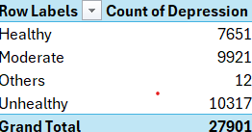
CORE COMPETENCIES LEARNED DURING INTERNSHIP Microsoft Excel
1.
Data cleaning, raw behavioral dataset preprocessing, and pivot table analysis.
Cleaned and organized raw student data.
Removed duplicate and missing values.
Applied formulas for data validation and calculations.
Formulas: IF(), COUNTIF(), SUM().
Created Pivot Tables to summarize key trends.
Prepared the dataset for Power BI analysis

Slide 3

2. Structured Query Language (SQL) : MYSQL
- Efficiently querying and extracting historical academic records from institutional relational databases.
Stored and managed student behavioral data in relational databases.
Eg : CREATE DATABASE, CREATE TABLE
Queried academic records using SQL statements.
Eg : SELECT
Retrieved and filtered data for analytical reporting.
Eg : WHERE, ORDER BY
Used JOIN operations to combine data from multiple tables.
Eg : INNER JOIN, LEFT JOIN
Applied aggregation functions for summary analysis.
Eg : COUNT(), AVG(), SUM(), MAX()
Extracted structured datasets for Power BI visualization.
Eg : SELECT INTO, EXPORT, VIEW

Slide 4

3. Python Programming :
- Using libraries like Pandas, NumPy, and Scikit-Learn to build, train, and validate machine learning models like KNN ,Decision tree, Linear regression.
Data Manipulation and Preprocessing – Pandas
(DataFrame, read_csv())
Numerical Computation and Analysis – NumPy
(array, mean(), reshape())
Data Visualization and Exploration – Matplotlib, Seaborn
Pie chart,Barchat,etc,.
Model Development and Training – Scikit-Learn
(fit(), predict())
Machine Learning Algorithms
KNN, Decision Tree, Linear Regression
Model Evaluation and Validation
train_test_split(), accuracy_score(), confusion_matrix()

Slide 5

4. Microsoft Power BI :
- Transforming complex model outputs into interactive, real-time executive dashboards.
Imported and transformed data using Power Query. Eg :( Data Cleaning, Remove Null Values)
Created interactive visualizations for data analysis. Eg :(Bar Chart, Pie Chart)
Developed custom calculations using DAX measures. Eg :(COUNT(), CALCULATE())
Enabled dynamic filtering and user-driven analysis. Eg :(Slicers, Cross-Filtering)
Generated insights through dashboards and reports. Eg :(KPI Cards, Interactive Dashboard)

Slide 6
5.Title:
Early Warning System for Academic Depression Using Data Science & Analytics
Project Description:
This project aims to identify students who are at risk of depression using Machine Learning and Data Analytics techniques.
A K-Nearest Neighbours (KNN) model was developed using student academic, lifestyle, and mental health data to predict depression risk.
An interactive Power BI dashboard was created to visualize key factors such as academic pressure, financial stress, sleep duration, dietary habits, and suicidal thoughts.
The system helps educational institutions identify high-risk students and support early intervention.

Slide 7
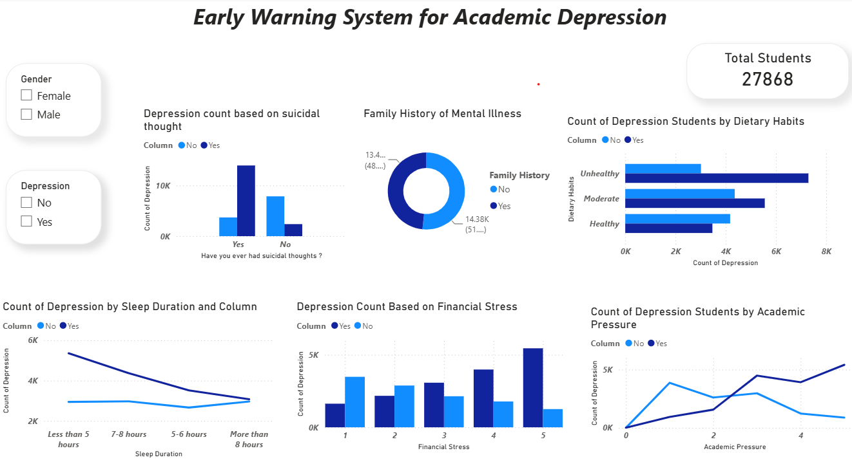
6. Visualization : Power BI

Slide 8
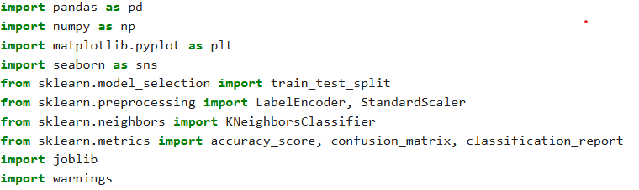

8.Python Program :
8.1 . Import Libraries :
8.2 . Load the data
8.3 . DATASET OVERVIEW AND STRUCTURE INSPECTION

Slide 9
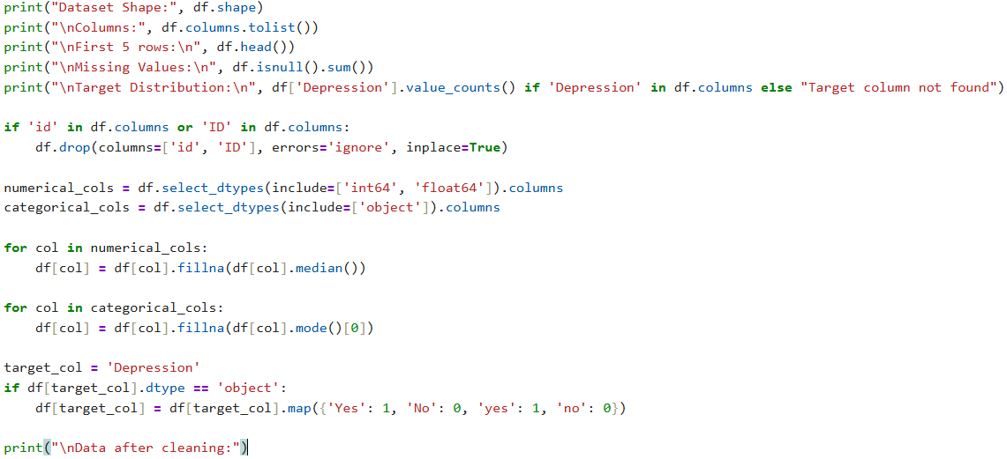
8.4 . Data cleaning Process :

Slide 10
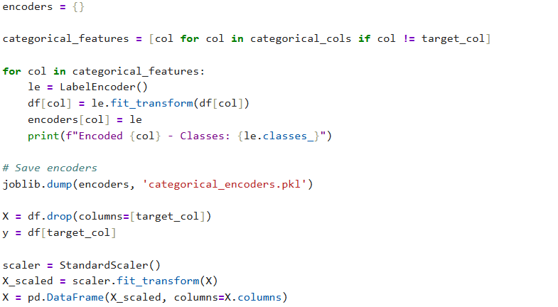
8.5 . Encoder and Scaler :
8.6 . Data spitting:

Slide 11
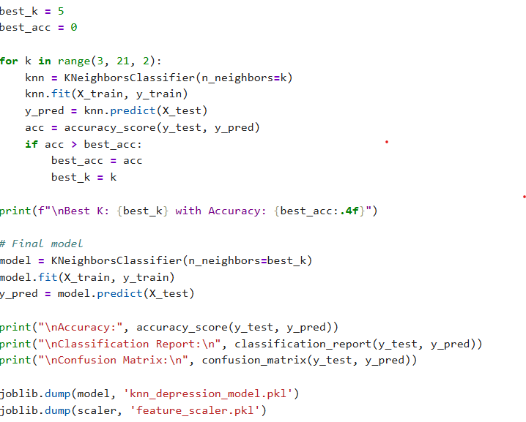
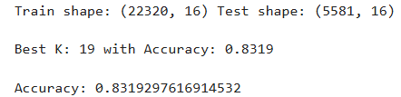
8.7 . Model Train and Save :

Slide 12

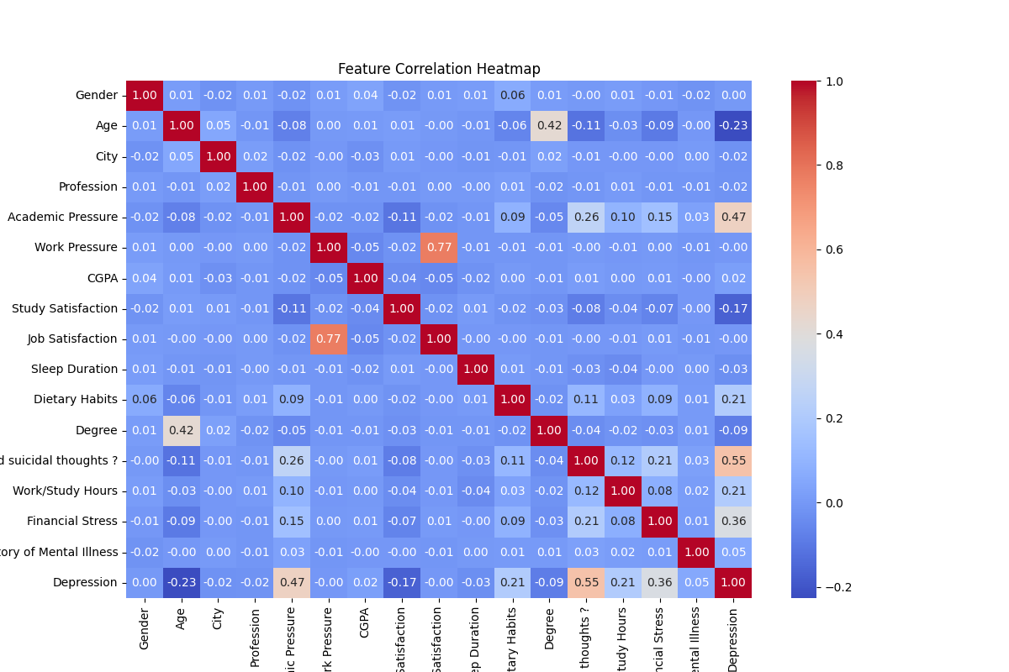
8.8 . Model Load:

Slide 13
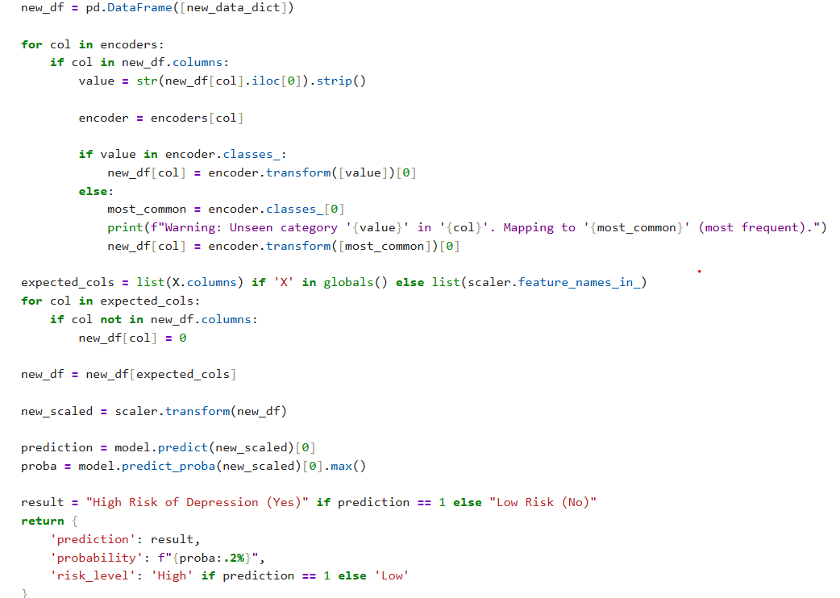
8.9 . New Data prediction :

Slide 14
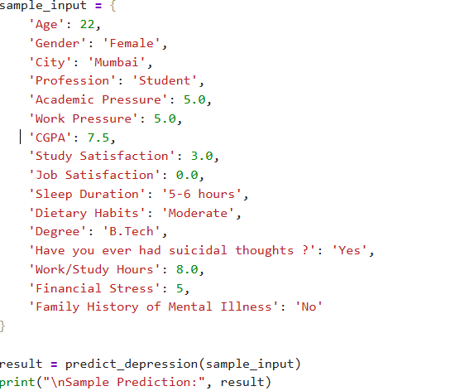
8.10 . New Input :
Output :

Slide 15
9. Conclusion :
Developed a KNN-based model to predict student depression risk.
Built an interactive Power BI dashboard for mental health analysis.
Identified key factors influencing depression, including academic pressure, financial stress, sleep patterns, and suicidal thoughts.
Enabled data-driven insights for early intervention and student support.
Demonstrated the practical use of Data Science and Analytics in mental health monitoring.

Slide 16
Thank You

